Slide 1
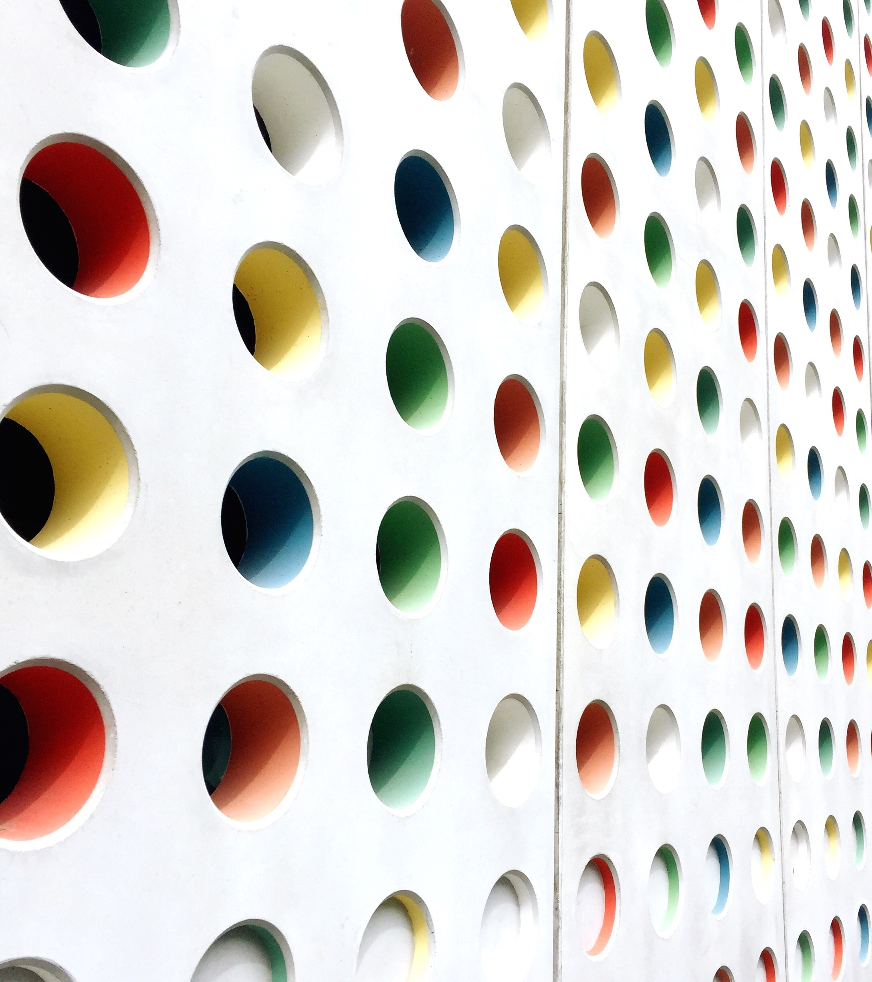
Custom CNN
Image Classification

Slide 2

Introduction
Justification for choosing the CIFAR-10 dataset.
Description of dataset characteristics, classes, and image dimensions.

Slide 3

Dataset Selection
Rationale for selecting CIFAR-10 dataset
Overview of CIFAR-10 dataset characteristics

Slide 4

Methodology
Base CNN architecture design
Activation functions: ReLU, Leaky ReLU, Sigmoid, Tanh
Convolutional layer configurations: varying filters, kernel sizes, strides

Slide 5

Implementation
Pseudocode for implementing base CNN architecture
Replacing activation functions and configuring convolutional layers

Slide 6

Experimental Results
Performance metrics for each activation function and configuration
Comparative plots showcasing accuracy, precision, recall, F1-score

Slide 7
Discussion
Summary of findings from activation function and layer configuration experiments
Evaluation of activation function and configuration strengths and weaknesses

Slide 8
Trends and Patterns
Analysis of trends and patterns observed in performance metrics
Visual representations of trends

Slide 9
Conclusion and Future Work
Analysis of trends and patterns observed in performance metrics
Visual representations of trends

Slide 10
Questions and Discussion
Open the floor for questions and discussion

